Slide 1
OVERVIEW OF BUILDING A DATA PIPELINE FOR PREDICTIVE ANALYTICS
Rajasekhar Jetty

Slide 2
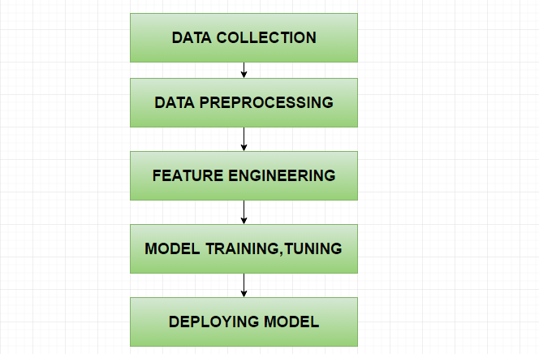
Phases

Slide 3
USECASE
Building a model to predict whether a transaction is a fraudulent one or not.

Slide 4
DATA COLLECTION
What kind of information do I have to consider?
Examples:
User transaction history, transaction metadata ,transaction value

Slide 5
DATA PREPROCESSING
Data Transformations
Encoding for categorical variables.(Dummy,Ordinal)
Handling NA values
Exploratory data analysis
Outliers check
Check whether current data sample represents the entire population.

Slide 6
FEATURE ENGINEERING
Domain Specific
Quantitative: Insurance, Marketing , Sales , Finance , Sensors
Computer Vision, NLP
Understand the business sense behind the each and every derived feature.
Good features will give a great boost to the model performance(accuracy).
In kaggle, often the top models have good feature engineering
in their implementation.

Slide 7
MODEL TRAINING & TUNING
What kind of algorithm should we choose?
Classification: (Binary, Multiclass)
Examples:
Trees , Ensemble Trees
Logistic Regression
SVM
Neural Networks with softmax
K Nearest Neighbours

Slide 8
MODEL TRAINING & TUNING
Regression:
Examples:
GLM,Ridge,Lasso,Elastic nets
Trees,Ensemble Trees
Neural networks

Slide 9
TUNING
Hyper parameter settings
K fold cross validation and choosing the right folds.
Variants : Subjects,Stores

Slide 10
DEPLOYING MODEL
Build a web service to invoke the model whenever test entry is provided. The service should collect the prediction and return it.
Maintain the updated versions of the model in the backend.
Environment : Cloud or running locally on the host.

